Slide 1
Demystifying Data: Effective Communication Strategies for Data Analysts

Slide 2



Introduction
In today's data-driven world, effective communication is crucial for data analysts. This presentation will explore strategies for clear and impactful communication of data ﬁndings.

Slide 3



Know Your Audience
Understanding the stakeholders' needs and level of data literacy is essential for tailoring your communication. Adapt your message to resonate with your audience.

Slide 4



Storytelling with Data
Craft a compelling narrative around the data to engage your audience. Use visualizations and anecdotes to bring the data to life and make it memorable.

Slide 5






SIMPLIFY COMPLEX CONCEPTS
Break down complex data into digestible insights. Use clear visuals and plain language to convey the message without overwhelming your audience.

Slide 6




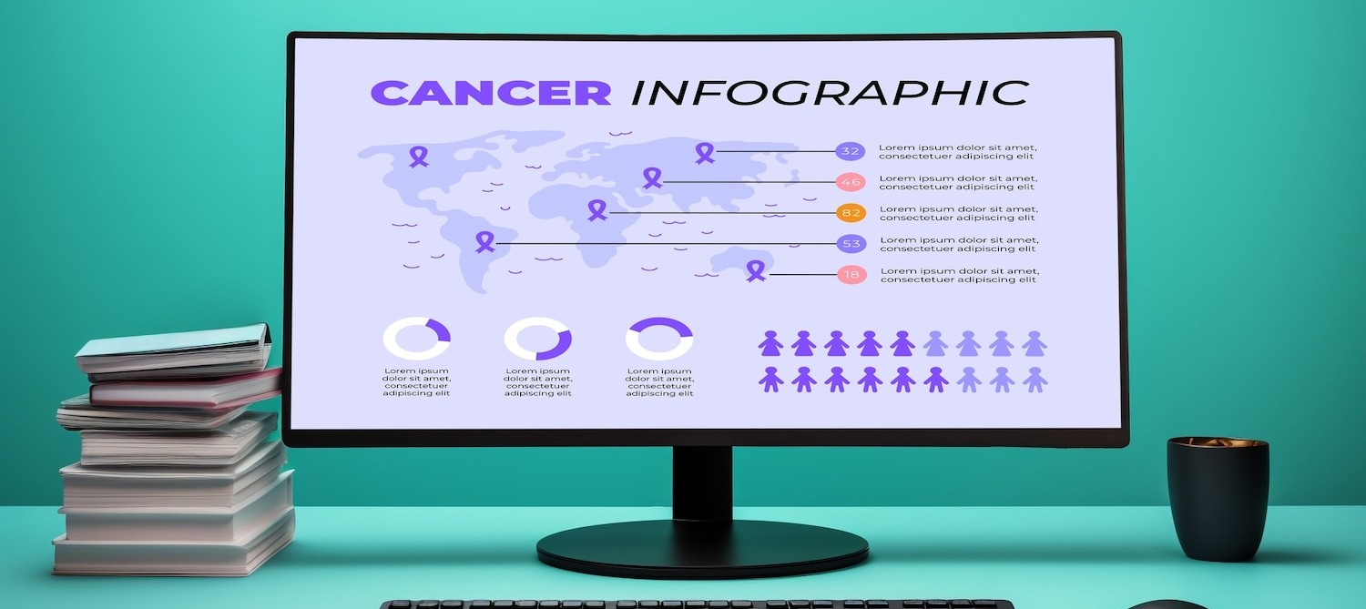
VISUAL COMMUNICATION
Leverage charts, graphs, and infographics to convey information visually. Ensure that the visuals are clear and aligned with the key messages.

Slide 7




Engage in Dialogue
Encourage questions and discussion to ensure that the data is well understood. Active engagement with the audience fosters a deeper understanding of the insights.

Slide 8



Data Visualization Tools
Explore various data visualization tools to create impactful visuals. Choose tools that enable interactive exploration of the data for a more engaging experience.

Slide 9

CONCLUSION
Effective communication of data is a vital skill for data analysts. By understanding your audience, telling a compelling story, and using clear visuals, you can demystify data and drive impactful decision-making.

